Slide 1
IPv4 Subnetting and Network Implementation
Instructor: Rattapol Kasemrat
Duration: 4 Hours
Topics: Subnetting, VLANs, Ethernet LANs, IPv4 Routing

Slide 2
Learning Objectives
Understand and configure IPv4 subnetting
Implement VLANs and Ethernet LANs
Learn how switches process MAC addresses
Configure and verify basic IPv4 routing
Conduct hands-on workshops in Packet Tracer

Slide 3
Introduction to IPv4 Subnetting
What is subnetting?
Dividing an IP network into smaller segments
Helps in network efficiency, security, and management
Subnet vs. Network - Reducing broadcast traffic and improving performance

Slide 4
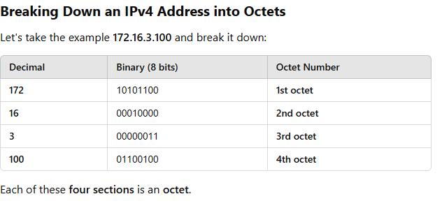
What is an Octet in IPv4 Addressing?
An IPv4 address is a 32-bit number divided into four sections. Each section is called an octet, and it consists of 8 bits.
💡 Example of an IPv4 Address: 192.168.1.1
This address consists of four octets separated by dots (.).
Each octet can have a value between 0 and 255 because:
8 bits = 2⁸ = 256 possible values (from 0 to 255).
Real-Life Analogy
Think of an IPv4 address like a house address:
📌 172.16.3.100
172.16 → The city (fixed part in Class B)
3 → The street (subnet)
100 → The house number (host ID)
Summary
An octet is an 8-bit section of an IPv4 address.
IPv4 addresses have 4 octets.
Each octet ranges from 0 to 255.
Subnetting changes specific octets to divide a network into smaller parts.
Why Are Octets Important?
Class A, B, C networks define the number of fixed and variable octets.
Subnetting is done by changing bits in specific octets.
For example, in a Class B network (172.16.0.0):
The first two octets (172.16) stay fixed.
The last two octets (x.x) can be used for subnetting.

Slide 5
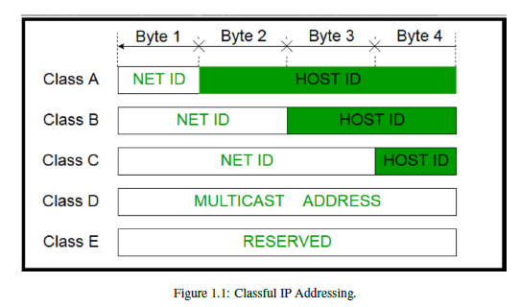
This table describes how different classes of IPv4 addresses are structured:
Class A:
Network ID: 1st byte (8 bits)
Host ID: 2nd, 3rd, and 4th bytes (24 bits)
Example Range: 1.0.0.0 to 126.255.255.255
Use Case: Large organizations requiring a massive number of hosts.
Class B:
Network ID: 1st and 2nd bytes (16 bits)
Host ID: 3rd and 4th bytes (16 bits)
Example Range: 128.0.0.0 to 191.255.255.255
Use Case: Medium-sized networks.
Class C:
Network ID: 1st, 2nd, and 3rd bytes (24 bits)
Host ID: 4th byte (8 bits)
Example Range: 192.0.0.0 to 223.255.255.255
Use Case: Small businesses and offices.
Class D (Multicast Addresses):
Used for multicast communication (e.g., video streaming, group communications).
Example Range: 224.0.0.0 to 239.255.255.255
Class E (Reserved):
Reserved for future use or research.
Example Range: 240.0.0.0 to 255.255.255.255

Slide 6
What is Subnetting?
Subnetting is dividing a large network into smaller, more manageable subnetworks (subnets). It helps improve network efficiency, security, and organization.
Why Do We Need Subnetting?
Efficient IP Address Utilization
Prevents wastage of IPs by dividing a large network into smaller parts.
Reduces Network Congestion
Limits broadcast traffic within each subnet.
Improves Security
Helps isolate different departments (e.g., HR and IT in different VLANs).
Easier Network Management
Simplifies troubleshooting and network control.
How Does Subnetting Work?
An IPv4 address consists of four octets (e.g., 192.168.1.1).
A subnet mask defines which part of the IP is the network and which is for hosts.
Example:
192.168.1.0/24 (Subnet Mask: 255.255.255.0)
Network ID: 192.168.1 (Fixed)
Host Range: 192.168.1.1 - 192.168.1.254
Broadcast Address: 192.168.1.255
Example: Splitting a Network
Given 192.168.1.0/24 (256 addresses), we need two subnets:
Subnet 1: 192.168.1.0/25 (128 addresses)
Subnet 2: 192.168.1.128/25 (128 addresses)

Slide 7
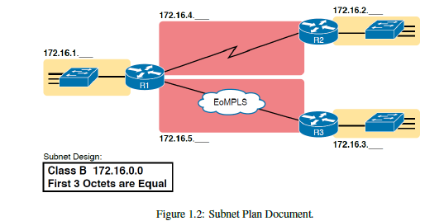
What This Means:
Subnetting a Class B network helps divide it into smaller, manageable pieces.
Each router is assigned a different subnet to organize network traffic efficiently.
The first three octets remain the same, while the last octet varies to define different subnets.
This diagram shows a Class B network (172.16.0.0) divided into subnets.
The first three octets are fixed (172.16.x.x), meaning only the last octet (x) changes for subnetting.
Each router (R1, R2, R3) has different subnets:
172.16.1.x
172.16.2.x
172.16.3.x
172.16.4.x
172.16.5.x
The network is connected through Ethernet over MPLS (EoMPLS), a technology that allows different sites to communicate as if they were in the same LAN.

Slide 8
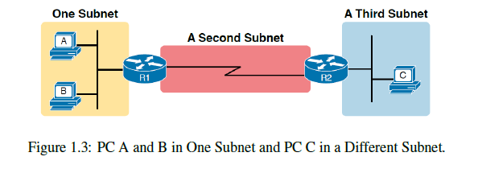
This image explains how devices are grouped into subnets and how routers connect different subnets.
Key Concepts in the Image
Same Subnet (No Router Needed) ✅
PC A and B are in the same subnet (yellow section).
They can communicate directly because they belong to the same IP range.
No router is needed for their communication.
Different Subnet (Router Needed) 🔀
PC C is in a different subnet (blue section).
To communicate with PC A or B, PC C must send data through a router (R2).
Router Connects Multiple Subnets 🌐
Routers are used to separate subnets and help devices communicate across them.
In the image:
R1 connects Subnet 1 (A & B) to Subnet 2.
R2 connects Subnet 2 to Subnet 3 (C).
WAN Links Also Need Subnets 🌍
The red middle section (Second Subnet) represents a Wide Area Network (WAN) link.
Even router-to-router connections require IP addresses and belong to a subnet.
Key Takeaways
Devices in the same subnet can talk directly without a router.
Different subnets require a router to communicate.
Routers connect multiple subnets to allow communication between them.
Even router-to-router connections need IP subnets.

Slide 9
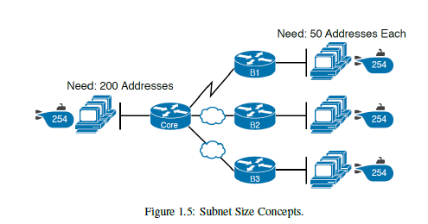
Key Points from the Image
Different Locations Need Different IPs
Main Office (Core Network) → Needs 200 IPs
Branch Offices (B1, B2, B3) → Need 50 IPs each
Subnet Mask Determines the Number of Usable IPs
Each subnet is using /24 (255.255.255.0), which provides 254 IPs.
This means even if only 50 IPs are needed, 254 are assigned!
Wasted IPs: Every small branch is assigned more IPs than needed.
WAN Links Also Need IPs
WAN (Router-to-Router) connections only need 2 IPs.
But if they use /24, they get 254 addresses, wasting 252 IPs!
Better Solution?
Instead of giving every subnet 254 addresses,
we can use variable subnet sizes:
Main Office: /24 (254 IPs) ✅
Branch Offices: /26 (62 IPs) ✅
WAN Links: /30 (2 usable IPs) ✅
This way, no IPs are wasted! 🚀

Slide 10
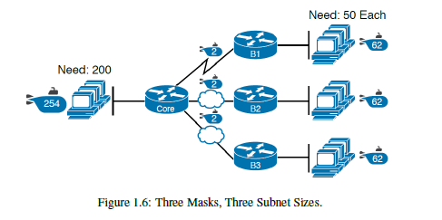
Different Locations Need Different IPs
Main Office (Core Network) → Needs 200 IPs ✅
Branch Offices (B1, B2, B3) → Need 50 IPs each ✅
WAN Links → Need only 2 IPs ✅
Using One Subnet Size Wastes IPs
If we used /24 (254 IPs) for every location, we would waste a lot of IPs.
Instead, we use different subnet sizes:
Main Office → /24 (254 IPs)
Branches → /26 (62 IPs)
WAN Links → /30 (2 usable IPs)
✅ This way, we don't waste addresses!

Slide 11
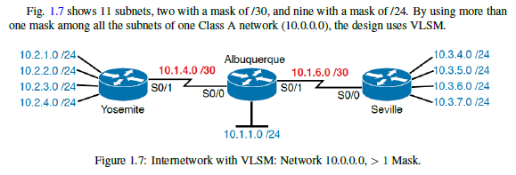
Shows a real network using VLSM:
Large networks use /24 (254 IPs)
WAN links use /30 (2 IPs)
Smaller networks use /30 or /26
💡 Key Takeaway: With VLSM, we can assign the right subnet size to each part of the network, saving IPs and improving efficiency. 🚀
VLSM stands for Variable-Length Subnet Masking 🚀
What is VLSM?
VLSM is a technique that allows different subnet sizes within the same network. Instead of using one fixed subnet size for all parts of a network, VLSM allows us to assign larger subnets where more IPs are needed and smaller subnets where fewer IPs are required.

Slide 12
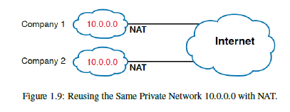
Key Concepts
Both Company 1 & Company 2 Use the Same Private Network (10.0.0.0/8)
Company 1 is using 10.0.0.x IPs.
Company 2 is also using 10.0.0.x IPs.
Even though both companies use the same private IP addresses, their networks remain separate.
NAT (Network Address Translation) Converts Private IPs to Public IPs
Each company's NAT device (router/firewall) translates private IPs into a public IP before sending traffic to the Internet.
This prevents IP conflicts on the global Internet.
Example:
A device in Company 1 (10.0.0.5) can send traffic through NAT to the Internet.
A device in Company 2 (10.0.0.5) can do the same, and their NAT devices ensure that their traffic remains separate.
Why is NAT Important?
Saves Public IPs: Instead of assigning every device a public IP, companies can use private IPs and share one public IP.
Allows Reuse of Private IPs: Different companies can use the same private network without issues.
Ensures Security: NAT hides internal IP addresses from external networks.

Slide 13
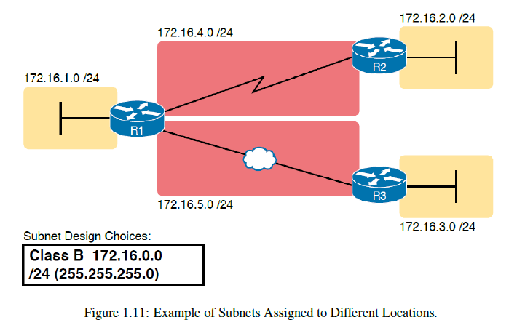
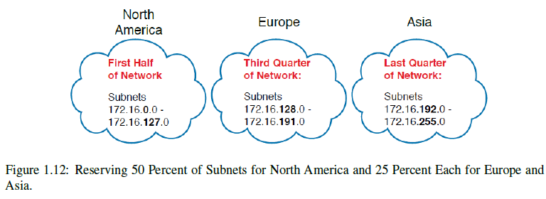
Figure 1.11: Assigning Subnets to Different Locations
The network engineer assigns subnets to different locations using a Class B network (172.16.0.0/24).
Each location (LAN or WAN) gets a unique subnet:
LANs (like offices) use lower subnets (e.g., 172.16.1.0/24, 172.16.2.0/24).
WAN links (router-to-router connections) use higher subnets (e.g., 172.16.4.0/24, 172.16.5.0/24).
This organization helps in easy network management and routing.
Figure 1.12: Subnet Allocation by Region
Instead of assigning subnets randomly, the network is divided geographically:
North America → 172.16.0.0 - 172.16.127.0 (50% of addresses)
Europe → 172.16.128.0 - 172.16.191.0 (25%)
Asia → 172.16.192.0 - 172.16.255.0 (25%)
Why?
Easier route summarization (simplifies routing tables).
Keeps regional networks organized for future growth.

Slide 14
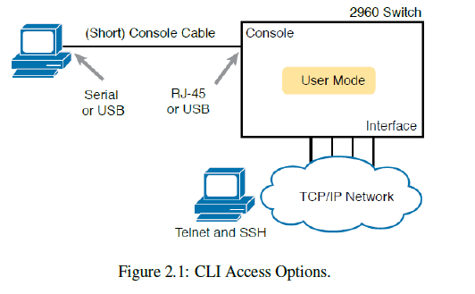
Figure 2.1: CLI Access Options
This figure shows three ways to access the Cisco Command-Line Interface (CLI) of a switch:
Console (Direct Connection)
Uses a serial or USB cable to connect directly.
Requires physical access to the device.
Telnet (Remote Login, Not Secure)
Allows remote access over the network.
Not encrypted (not recommended for security).
SSH (Remote Login, Secure)
Like Telnet but encrypted, making it safer.
Recommended for managing network devices securely.
💡 Key Takeaway: Use Console for direct access and SSH for remote access (avoid Telnet for security reasons).

Slide 15
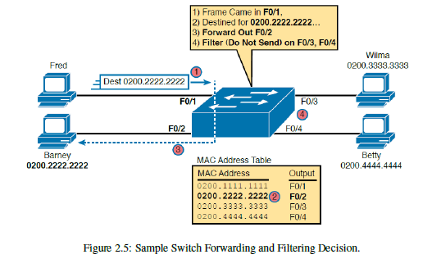
How the Switch Processes Frames
A frame arrives at the switch on port F0/1
The source is Barney (MAC: 0200.2222.2222).
The destination is Fred (MAC: 0200.2222.2222).
The Switch Checks Its MAC Address Table
The table maps MAC addresses to specific ports:
0200.2222.2222 → F0/2
0200.3333.3333 → F0/3
0200.4444.4444 → F0/4
The Switch Decides How to Forward the Frame
Since 0200.2222.2222 is mapped to F0/2, the switch forwards the frame to F0/2.
The frame is NOT sent to F0/3 and F0/4 (filtering decision).

Slide 16
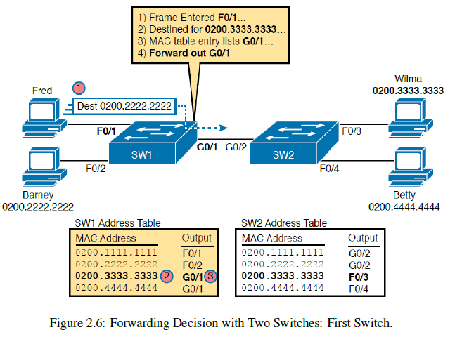
Step-by-Step Explanation
A frame arrives at Switch 1 (SW1) on port F0/1
The source MAC is from Fred (0200.2222.2222).
The destination MAC is Wilma (0200.3333.3333).
SW1 Checks Its MAC Address Table
The switch looks for 0200.3333.3333 in its table.
It finds that this MAC address is reachable via port G0/1.
Decision: Forward the frame out of G0/1 towards SW2.
The Frame Moves to SW2 via G0/1
SW2 receives the frame on G0/1.
SW2 checks its own MAC table and finds 0200.3333.3333 is on port F0/3.
Decision: Forward the frame out of F0/3 to reach Wilma.

Slide 17
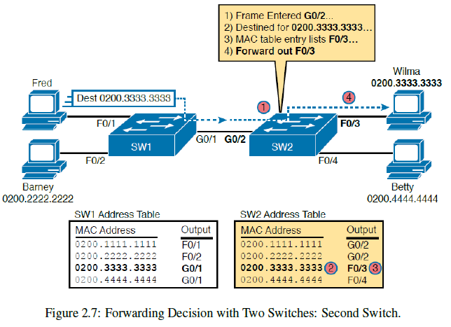
This figure continues from Figure 2.6 and shows how Switch 2 (SW2) processes the frame after receiving it from Switch 1 (SW1).
Step-by-Step Explanation
The Frame Arrives at SW2 on Port G0/2
The source MAC address is from Fred (0200.2222.2222).
The destination MAC address is Wilma (0200.3333.3333).
SW2 Checks Its MAC Address Table
It looks for 0200.3333.3333 in its table.
It finds that this MAC address is connected to port F0/3.
SW2 Forwards the Frame Out of Port F0/3
Since Wilma (0200.3333.3333) is on F0/3, the switch forwards the frame out of F0/3.
Wilma receives the frame successfully.

Slide 18
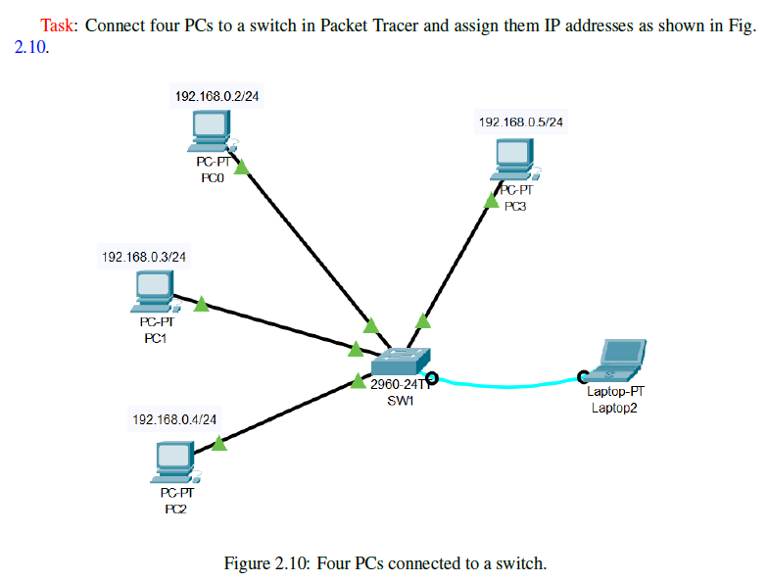

Slide 19
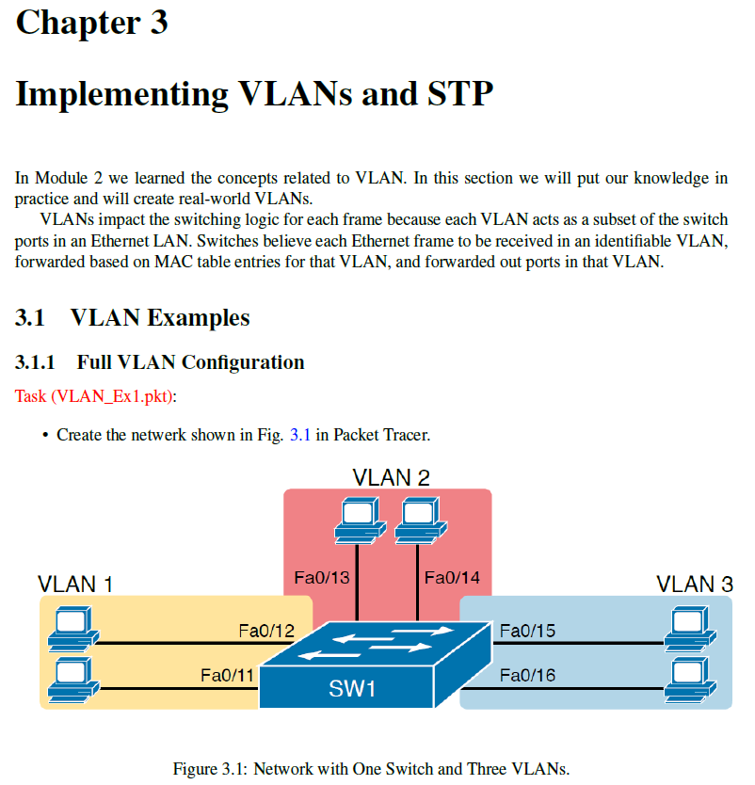

Slide 20
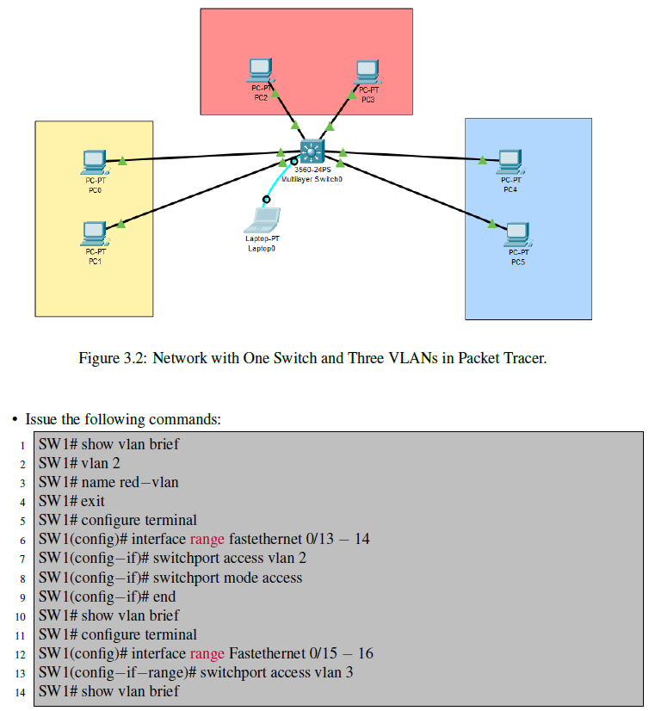

Slide 21
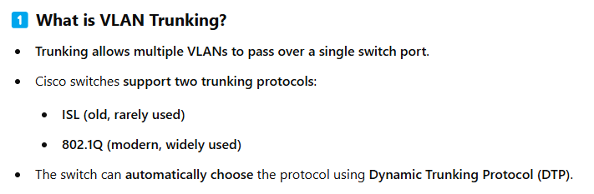
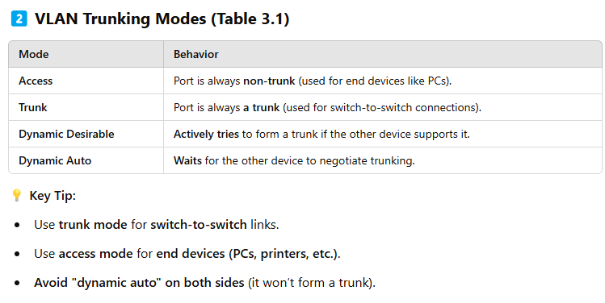

Slide 22
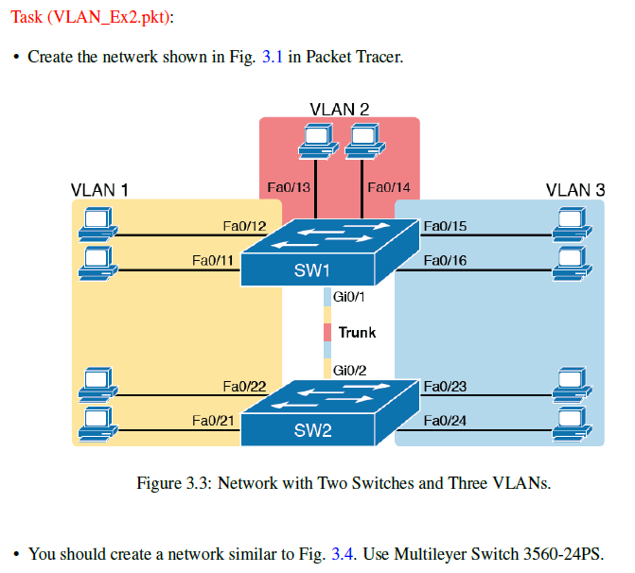

Slide 23
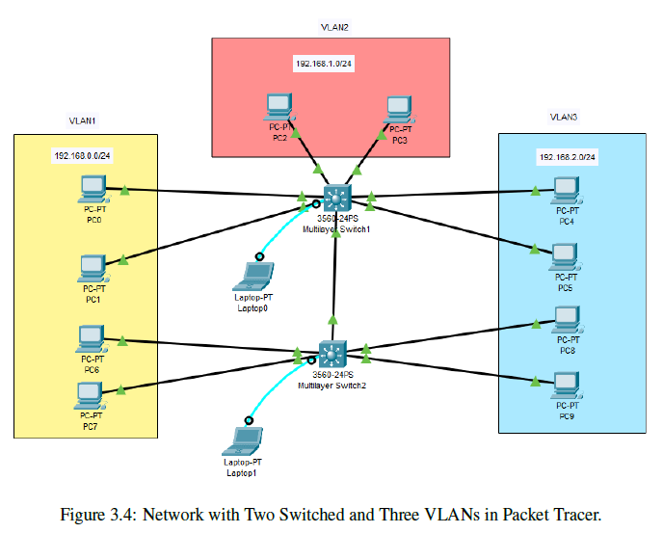

Slide 24
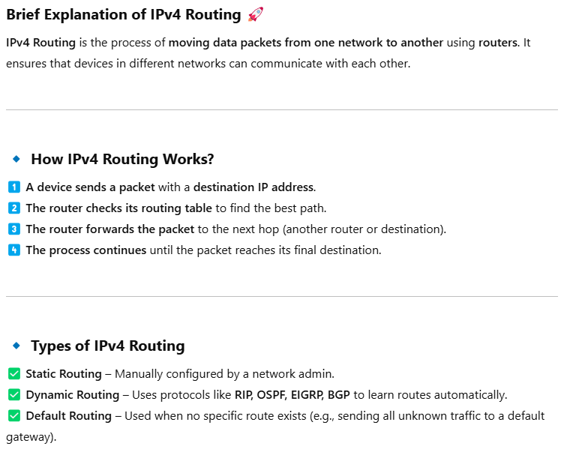

Slide 25
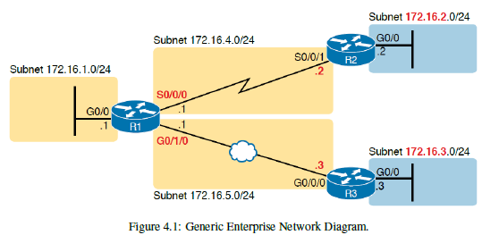
This diagram shows how different sites in a network are connected using routers and subnets.
Key Points:
✅ Routers (R1, R2, R3) connect different sites ✅ Each site has its own subnet (e.g., 172.16.1.0/24, 172.16.2.0/24) ✅ WAN Links (Serial Connections) connect remote locations ✅ Ethernet Links (G0/0, G0/1) connect LANs within the sites
💡 Simple Understanding:
R1 is the main router, connecting to other routers (R2 & R3) via WAN links.
Each router has a unique subnet for devices at its location.
WAN links use serial connections, while LANs use Ethernet connections.

Slide 26
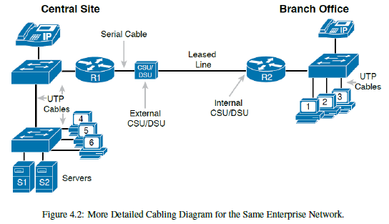
This figure adds physical details to the network from Figure 4.1, showing how devices are connected.
Key Points:
✅ Shows actual cables (UTP, Serial) used for connections ✅ Central Site (R1) is connected to Branch Office (R2) using a leased line ✅ CSU/DSU devices are needed for serial WAN connections ✅ Switches and Servers are shown in the network
💡 Simple Understanding:
UTP cables connect local devices (PCs, servers) to switches.
A serial cable connects the routers over a WAN link using CSU/DSU.
Branch Office (R2) is connected to local devices via a switch.

Slide 27
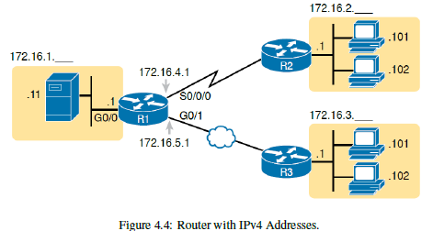
1️⃣ Router R1 connects different networks using multiple interfaces:
G0/0 (GigabitEthernet 0/0) → Local Network 172.16.1.0/24
S0/0/0 (Serial 0/0/0) → WAN Link to R2 (Subnet 172.16.4.0/24)
G0/1 (GigabitEthernet 0/1) → WAN Link to R3 (Subnet 172.16.5.0/24)
2️⃣ Each router interface has an assigned IPv4 address.
R1 uses 172.16.4.1 for its link to R2
R1 uses 172.16.5.1 for its link to R3
3️⃣ Subnetworks for different locations:
172.16.1.0/24 (LAN with PC .11, Router R1 .1)
172.16.2.0/24 (LAN for R2 with PCs .101, .102)
172.16.3.0/24 (LAN for R3 with PCs .101, .102)

Slide 28
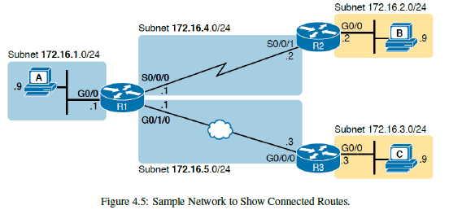
This figure demonstrates how a router (R1) automatically learns and adds directly connected routes to its routing table.
🔹 What’s Happening in the Diagram?
1️⃣ Router R1 connects multiple networks using different interfaces:
G0/0 (GigabitEthernet 0/0) → Subnet 172.16.1.0/24 (PC A's network)
S0/0/0 (Serial 0/0/0) → Subnet 172.16.4.0/24 (WAN link to R2)
G0/1/0 (GigabitEthernet 0/1/0) → Subnet 172.16.5.0/24 (WAN link to R3)
2️⃣ Each router interface is assigned an IP address.
R1 uses 172.16.4.1 for its link to R2
R1 uses 172.16.5.1 for its link to R3
PCs in subnets 172.16.1.0, 172.16.2.0, and 172.16.3.0 connect via routers
3️⃣ How Connected Routes Work:
When an interface on R1 is enabled (up/up) and assigned an IP, it automatically adds the subnet to its routing table.
This means R1 does not need static or dynamic routing for these directly connected networks—it already knows them.

Slide 29
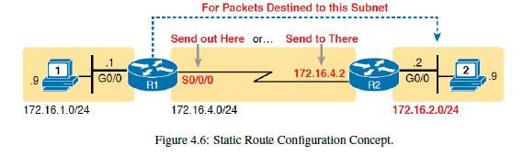
This figure explains how Router R1 is manually configured with a static route to reach another network.
🔹 What’s Happening in the Diagram?
1️⃣ The Goal:
PC on Network 172.16.1.0/24 (left side) wants to send data to PC on Network 172.16.2.0/24 (right side).
R1 does NOT have a direct connection to 172.16.2.0/24, so it must send traffic via R2.
2️⃣ Static Route on R1:
R1 needs a manual entry in its routing table so it knows how to forward packets to 172.16.2.0/24.
The static route tells R1:
"For any packet going to 172.16.2.0/24, send it via S0/0/0 (serial interface) or to next-hop router R2 (IP 172.16.4.2)."
3️⃣ Two Ways to Configure the Static Route on R1:
Using the outgoing interface: ip route 172.16.2.0 255.255.255.0 S0/0/0
Using the next-hop IP address: ip route 172.16.2.0 255.255.255.0 172.16.4.2
Both commands achieve the same result

Slide 30
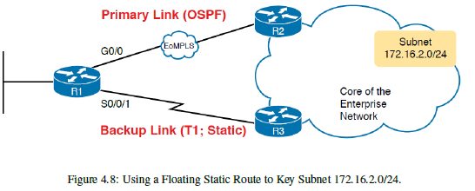
🔹 What’s Happening in the Diagram?
1️⃣ Two Paths to Reach Subnet 172.16.2.0/24:
Primary Link (OSPF) → Fast Ethernet Link via R2
Backup Link (Static) → Slower T1 Link via R3
2️⃣ How does the Router decide which Route to Use?
OSPF Route (Dynamic Routing) has an administrative distance of 110.
Static Route (by default) has an administrative distance of 1 (more preferred).
If both routes exist, R1 would choose the static route, even though it's slower.
3️⃣ Fixing the Issue with a Floating Static Route:
The engineer wants the router to use the OSPF route first and only use the static route if the primary link fails.
To do this, the static route’s administrative distance is increased to a higher value (e.g., 120 or more), so OSPF is preferred when available.

